Slide 1


WellBot -Well.ca's
Pharmacy Chatbot:
Final Report
Date: August 21 2023
Prepared by: Aasna Shah, Mahrukh Shamas, Rodrigo Castro

Slide 2

Overview
Well.ca is an online retailer that operates exclusively online and and focuses on offering a wide range of products related to health, wellness, and beauty.
The company has over 100 employees in their offices in Guelph and Toronto and sells over 40,000 different products online.
Established in 2008 by Ali Asaria, Well.ca was guided by a central vision to provide the customers with essential product purchases.

Slide 3
Problem Statement
MAIN PROBLEM:
Well.ca lacks a proper chatbot, which impacts the quality of customer service and prevents the automation and integration of processes.
Areas of improvement:
Customer website experience
Efficiency of customer interactions
Cost-effective service for a larger customer base

Slide 4


Solution
Implement WellBot
Well.ca's Pharmacy Chatbot
Objective
Provide Well.ca with a solution that expands their online pharmacy services as well as improve their customer experience.
Main Task
Build a chatbot for:
Order Medication (new prescriptions, transfers, drug price estimation)
Prescription Management (refills, drugs availability, order status)
Medication Information (general, dosage, allergies)
Feedback

Slide 5
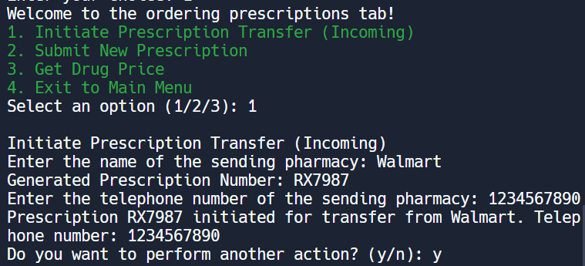
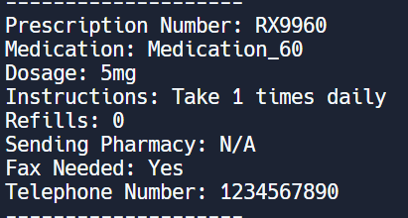
Scenario 1 - Medication Order
Initiate Prescription Transfer (Incoming)
Description: Customers can initiate the transfer of an incoming prescription. The user provides details like the sending pharmacy's name, telephone number, etc. A random prescription number is generated, and the prescription information is added to the prescriptions dictionary and JSON file.
This is a replicated service from Well.ca
Rationale: Common scenario in pharmacy operations as customers move prescriptions for various reasons.
Enhancement: This method streamlines the customer order process by providing a convenient way for patients to change pharmacies and fill their medications.
[

Slide 6
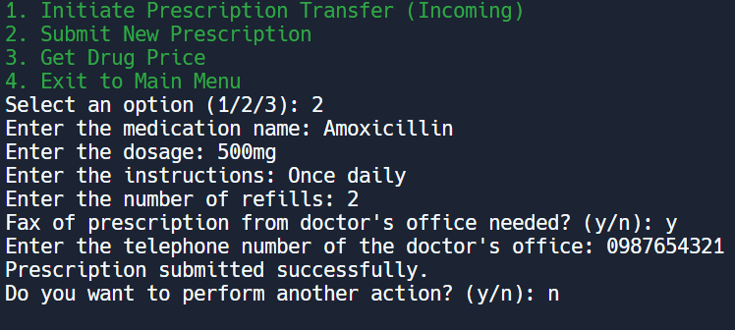
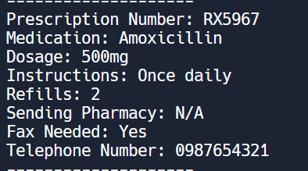
Scenario 1 - Medication Order
Submit New Prescription
Description: Customers can submit a new prescription by entering medication details. The user provides medication names, dosages, instructions, and refills. The user is prompted for a telephone number depending on whether a fax is needed. The prescription is added to the prescriptions dictionary and JSON file.
This is a replicated service from Well.ca
Rationale: Caters to customers who have new prescriptions from their healthcare providers.
Enhancement: Remote prescription submission, dispensing error reduction, and fax communication enable customers to submit prescriptions quickly and accurately.
[

Slide 7
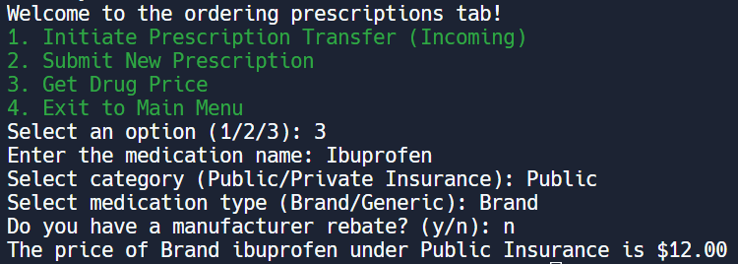
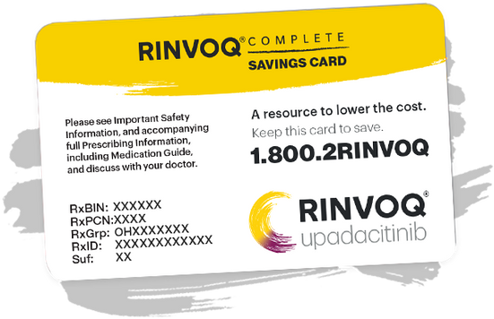
Scenario 1 - Medication Order
Get Drug Price
Description: Customers can check the drug price for a medication. The user provides the medication name, insurance category, and type (brand/generic). If the user has a manufacturer rebate, it's considered in the price calculation. The calculated price is then displayed per the price Dataframe using the Pandas library.
This is a novel service not found on Well.ca.
Rationale: Providing drug price information helps customers manage their healthcare costs.
Enhancement: Transparency establishment, rebate consideration, effective cost management, and informed decisions are promoted in the customer base.
[

Slide 8
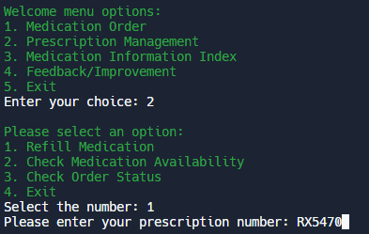
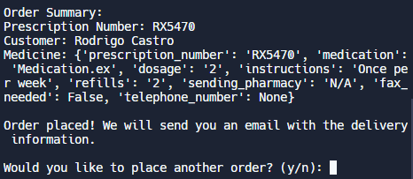
Scenario 2 - Presciption Management
Refill Prescription
Description: Customers are asked to enter their prescription number for a refill, which already exists in the prescription dictionary and JSON file. WellBot matches the prescription number with the corresponding medicine and instructions. Once confirmed, customers are notified that they will receive an email with delivery details.
This is a replicated service from Well.ca.
Rationale: Requesting refills allows patients to receive continuously their prescribed medication.
Enhancement: Reduces wait times and minimizes errors for customer who require additional medication.

Slide 9
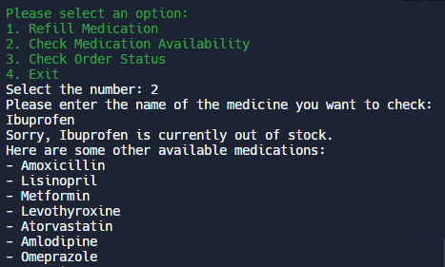
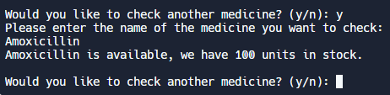
Scenario 2 - Presciption Management
Check Medicine Availability
Description: Customers can input a medicine name to check its stock. WellBot then matches the medicine to the stock Dataframe created using Pandas library. If the medicine is out of stock, the bot notifies the customer and presents alternative available medicines. If the medicine is in stock, WellBot displays the quantity of units available.
This is a novel service not found on Well.ca.
Rationale: Providing real-time availability allows customers to know if the medicine they need is in stock.
Enhancement: Enables customers to easily check medicine availability without the need to contact the call center, ensuring transparent and rapid access to information.

Slide 10
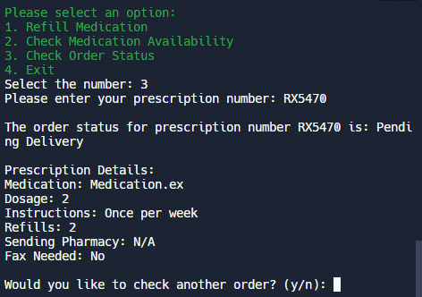
Scenario 2 - Presciption Management
Order Status
Description: Customers are asked to enter their prescription number, which already exists in the prescription dictionary and JSON file, for the status of their delivery. WellBot matches the prescription number to its corresponding order status, such as 'Pending Delivery'. However, if the status is 'Canceled', 'On Hold', or 'Rescheduled', WellBot recommends contacting the call center for further assistance.
This is a replicated service from Well.ca.
Rationale: Providing the delivery status of orders enables customers to know whether their order has been cancelled or is currently in transit.
Enhancement: Enables customers to easily check an order status without the need to contact the call center, reducing response times and improving customer service.

Slide 11
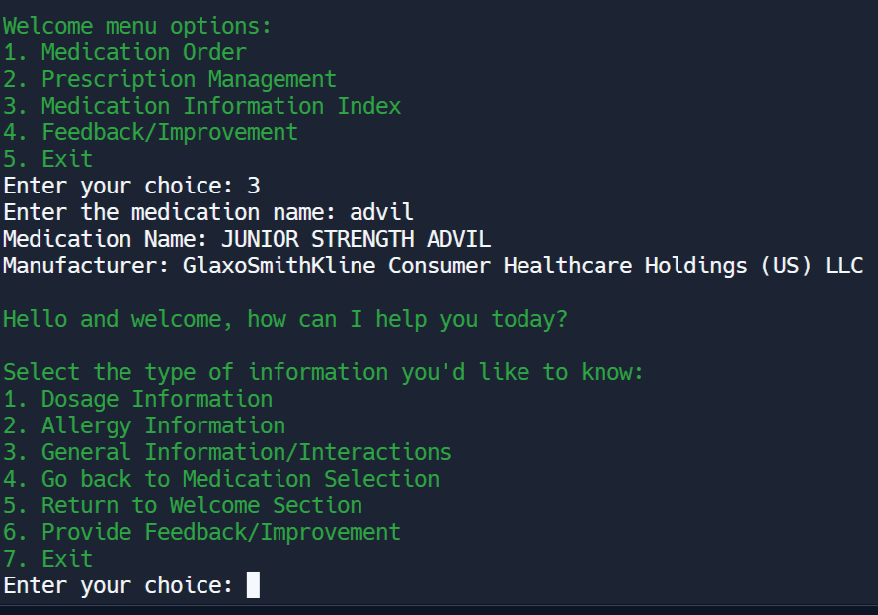
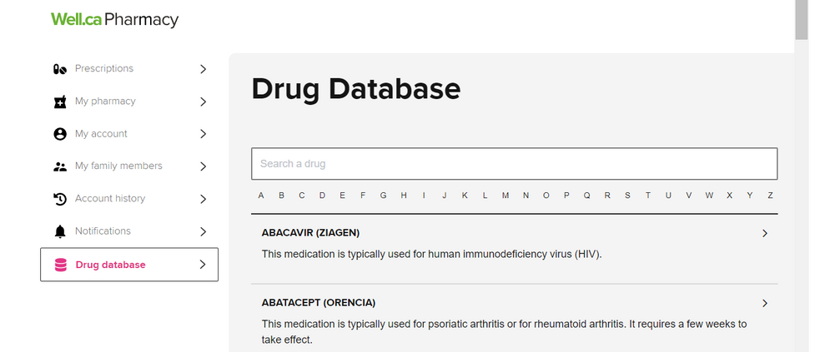
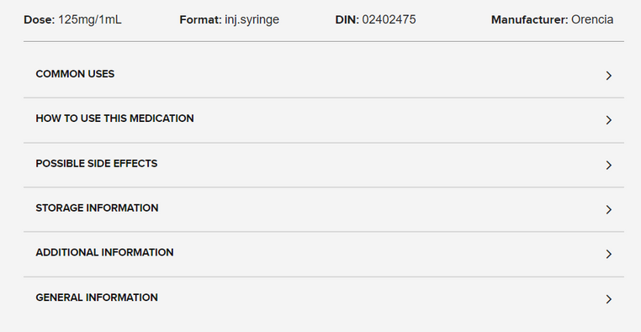
Scenario 3 - Medication Information Index
Dosage Information
Description: The dosage information tab works by pulling dosing and administration information about the drug inputted by the user from the Open FDA API.
This section is based on the drug database tab available on Well.ca Pharmacy. This is replicated by providing the user with information about the drug of their choice through the API.
Rationale: Allows users easy access to information about a drug of their choice to reduce the need for Well.ca pharmacy staff to answer common medication-related queries. It is also a great educational tool and enhances patient safety by ensuring that patients take the correct medication dosage.
Enhancement: Users can benefit from the chatbot's quick responses about a particular drug of interest, rather than reading through the drug database dictionary on Well.ca to find dosing information for a particular drug or contacting the Well.ca pharmacy.
Notes:
Describe each scenario that you considered briefly.
- If the chatbot replicates the current services that the retailer offers
from other online sources (e.g., web order, uber eats, etc.), mark
this as the replicated services.
- If you have suggested any additional services that retailers are not
offering, mark this scenario as the new scenario.
Include the
rationale for considering this scenario and how this scenario can
help users’ experience with the retailers.
[Note] If you have made the changes from your first group
assignment, describe how you changed the scenarios or what
scenario you have considered in the Appendix

Slide 12
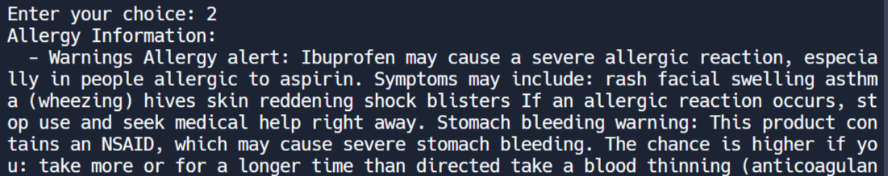

Scenario 3 - Medication Information Index
Allergy Information
Description: Allergy information of drugs is provided as part of the drug database section on Well.ca Pharmacy, so it is a replicated but more streamlined service.
This section is based on the drug database tab available on Well.ca Pharmacy. This is replicated by providing the user with information about the drug of their choice through the API.
Rationale: Providing allergy information is crucial for any pharmacy to ensure patient safety, reduce liability and educate patients. Providing this information on a chatbot also gives patients more accessible access to drug allergy information, reducing the need for patients to contact their pharmacies for information.
Enhancements: Reduces the time patients may spend looking through the drug database on Well.ca for information about their particular drug of interest.
Notes:
Describe each scenario that you considered briefly.
- If the chatbot replicates the current services that the retailer offers
from other online sources (e.g., web order, uber eats, etc.), mark
this as the replicated services.
- If you have suggested any additional services that retailers are not
offering, mark this scenario as the new scenario. Include the
rationale for considering this scenario and how this scenario can
help users’ experience with the retailers.
[Note] If you have made the changes from your first group
assignment, describe how you changed the scenarios or what
scenario you have considered in the Appendix

Slide 13
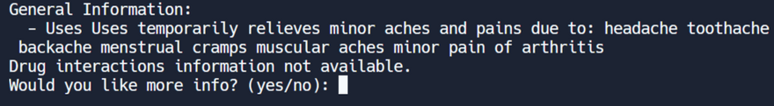
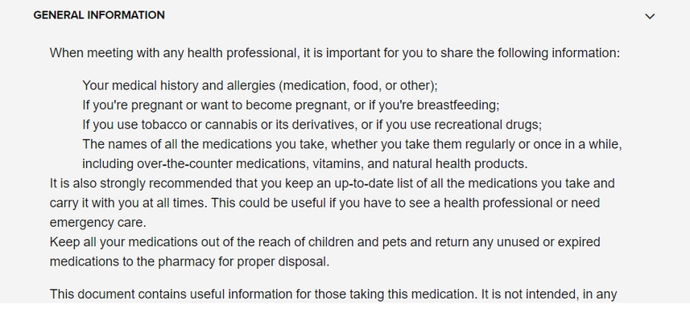
Scenario 3 - Medication Information Index
General Information/Interactions
Description: General information and interactions of drugs are provided as part of the drug database section on Well.ca Pharmacy, so it is a replicated but more streamlined service.
This section is based on the drug database tab available on Well.ca Pharmacy. This is replicated by providing the user with information about the drug of their choice through the API.
Rationale: Providing general information and information about interactions is crucial for any pharmacy to ensure patient safety, reduce liability and educate patients. Providing this information on a chatbot also gives patients more accessible access to drug information and instant response.
Enhancement: Reduces the time patients may spend looking through the drug database on Well.ca for information about their particular drug of interest.
From Well.Ca Drug Database
Notes:
Describe each scenario that you considered briefly.
- If the chatbot replicates the current services that the retailer offers
from other online sources (e.g., web order, uber eats, etc.), mark
this as the replicated services.
- If you have suggested any additional services that retailers are not
offering, mark this scenario as the new scenario. Include the
rationale for considering this scenario and how this scenario can
help users’ experience with the retailers.
[Note] If you have made the changes from your first group
assignment, describe how you changed the scenarios or what
scenario you have considered in the Appendix

Slide 14
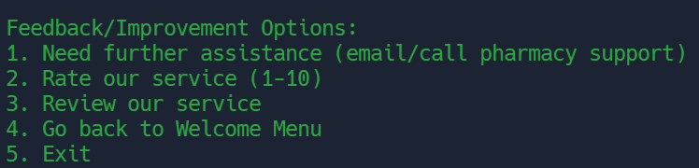
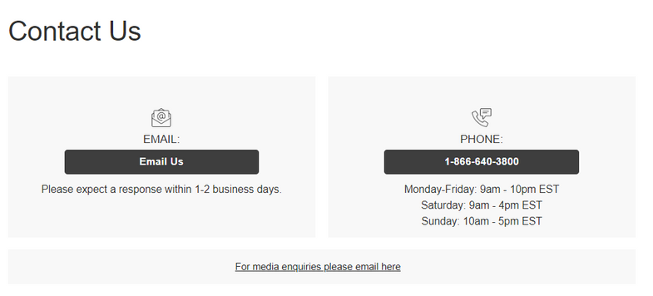
Scenario 4 - Feedback/Improvement
Need Further Assistance
Description: This section of the feedback/improvement scenario is modelled after the contact us page and provides users with the ability to access the phone number and email to contact Well.ca pharmacy for further assistance.
This is a replicated service from Well.ca
Rationale: This feature is important if patients need help with more complex queries beyond the chatbot's capabilities. Users of the chatbot may also encounter tech issues that need to be resolved.
Enhancement: Rather than scouring Well.ca webpages for contact info, this information is quickly and readily available through the chatbot.
Notes:
Describe each scenario that you considered briefly.
- If the chatbot replicates the current services that the retailer offers
from other online sources (e.g., web order, uber eats, etc.), mark
this as the replicated services.
- If you have suggested any additional services that retailers are not
offering, mark this scenario as the new scenario. Include the
rationale for considering this scenario and how this scenario can
help users’ experience with the retailers.
[Note] If you have made the changes from your first group
assignment, describe how you changed the scenarios or what
scenario you have considered in the Appendix

Slide 15
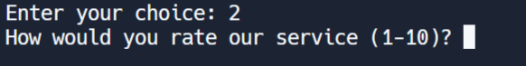

Scenario 4 - Feedback/Improvement
Rate Our Service (1 to 10)
Description: Users can choose to rate the chatbot from 1-10, and this information is stored in a JSON file for further analysis.
There is no rating service on Well.ca and thus this in tandem with the user reviews would be the only way for Well.ca to understand how users feel about their service
Rationale: The business can use the chatbot ratings from the JSON file to generate an average rating to gauge the users' sentiment. A lower rating indicates room for improvement and vice versa.

Slide 16
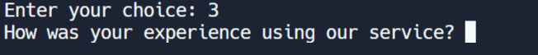

Scenario 4 - Feedback/Improvement
Review Our Service
Description: To supplement the ratings, users can choose to review the chatbot in a sentence or two. This information is then stored in a JSON file and put through VADER for further sentiment analysis.
This is a novel service not found on Well.ca.
Rationale: The business can view the results of the VADER sentiment analysis to understand how users feel about the chatbot and if there is any room for improvement. This will help them improve the existing service to build a robust chatbot.

Slide 17

Python Libraries + API's Used
Python Libraries and Packages
Random - generate random prescription numbers
Pandas - create stock and drug pricing data frame
JSON - store user registration info, prescription info, ratings and reviews
VADER Sentiment Analysis - analyze user reviews and provide a sentiment score
APIS:
Open FDA API - display medication information (dosage, interactions, general info, allergies, for the medication information index scenario)
Notes:
Suggest how you would like to integrate analytics Python libraries or API.
- Include the rationale for why the libraries are useful for the retailer’s service.
- Future suggestions for the code extension (e.g., additional python libraries).
You don’t need to write the code. You can share your idea and the proper python library. - Be creative!

Slide 18
Integration of Other Python Libraries + API's
Python Libraries
a. Visualization with matplotlib and seaborn:
Rationale: These libraries may be used to graphically represent customer interactions, feedback, and data like drug inventory making it easier for Well.ca to grasp trends and patterns.
b. TextBlob Sentiment Analysis Extension:
TextBlob can give extra-linguistic data to supplement VADER, such as part-of-speech identification, that might be valuable for better understanding user input.
APIS:
a. API for Medication Reminders:
Rationale: Sends reminders to users when a refill is due.
Suggested API: Integration with calendar APIs such as Google Calendar API or SMS reminder services such as Twilio.
b. API for Symptom Checker:
Users may explain their symptoms, and the chatbot will propose potential diagnoses or over-the-counter remedies.
Suggested API: Infermedica API
Notes:
Suggest how you would like to integrate analytics Python libraries or API.
- Include the rationale for why the libraries are useful for the retailer’s service.
- Future suggestions for the code extension (e.g., additional python libraries).
You don’t need to write the code. You can share your idea and the proper python library. - Be creative!

Slide 19

Suggestions for Well.ca
WellBot offers several benefits:
Cost Savings: Reduce the need for customer service staff.
24/7 Availability: Operate round the clock, providing customer support outside of regular business hours.
Efficient Customer Service: Quickly provide answers to common queries and perform routine tasks.
Consistent Information: Ensure that customers receive consistent and accurate information.
Data Collection and Analysis: Gather valuable data on customer interactions, preferences, and frequently asked questions.
Improved Efficiency: Enable pharmacy support staff to allocate more time to tasks that require human expertise.
Further Insights that can be derived in the future:
Medication Adherence Analysis: Track patients' medication adherence patterns, generating insights that aid in identifying trends and optimizing patient care plans.
Customer Feedback and Preferences: Provide valuable insights into customer preferences by analyzing interactions, enabling targeted marketing and service improvements.
Health Monitoring Integration: Integrate with wearable devices to monitor patients' health metrics, providing early intervention alerts and promoting proactive healthcare.
Telehealth Integration: Facilitate telehealth consultations, allowing patients to connect with pharmacists remotely for expert guidance.
Medication Management: Future iterations could remind patients to take medications, track dosages, and offer guidance on potential interactions.
Greater accessibility: Extend functionality to encompass communication in multiple languages and cater proficiently to a diverse array of accessibility needs.

Slide 20

References
Slide 1: https://images.crunchbase.com/image/upload/c_lpad,f_auto,q_auto:eco,dpr_1/v1452546777/cnr31psme7my4t1yxsdi.png
Slide 8:
https://www.rinvoq.com/content/dam/rinvoq/images/homepage/temp-cost-and-savings/savings-card_r13_mobile.png
Slide 11:
https://well.ca/index.php?main_page=prescription_drugs
Slide 13:
https://well.ca/index.php?main_page=prescription_drugs
Slide 14:
https://well.ca/contactus

Slide 21
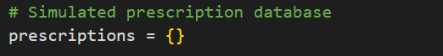
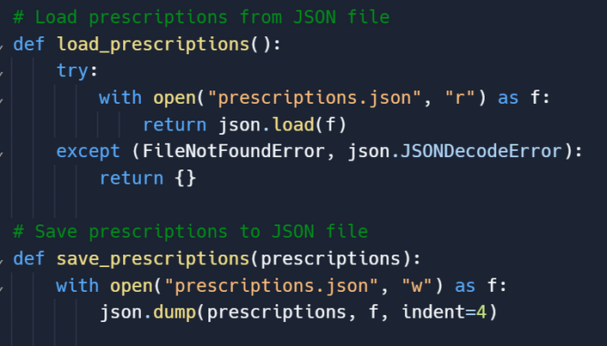
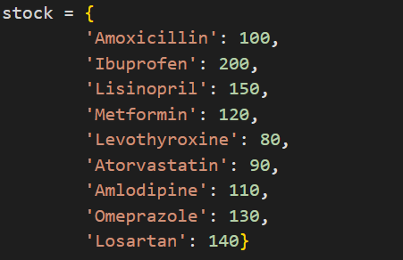

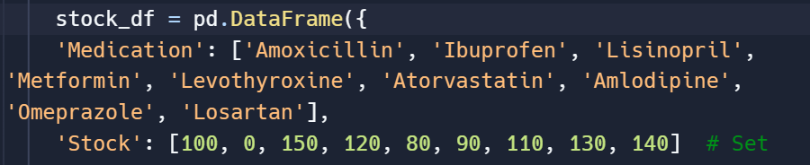
Appendix
i. The prescription dictionary was altered to a function connected to a JSON file to facilitate a connection between the medication order and prescription management. Allowing users to enter prescriptions they ordered into the prescription management tab for refills or other purposes.
ii. For the prescription management scenario, the stock dictionary was changed to a pandas dataframe and connects to the order_status function to provide the user with medication inventory information.

